Slide 1
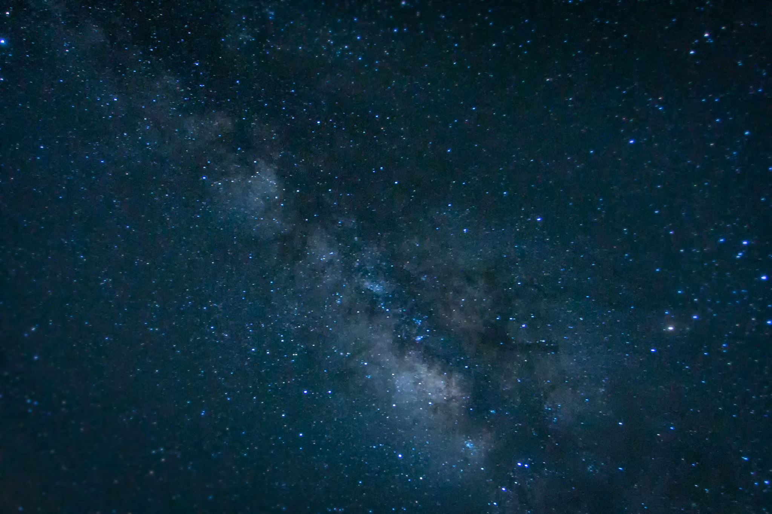
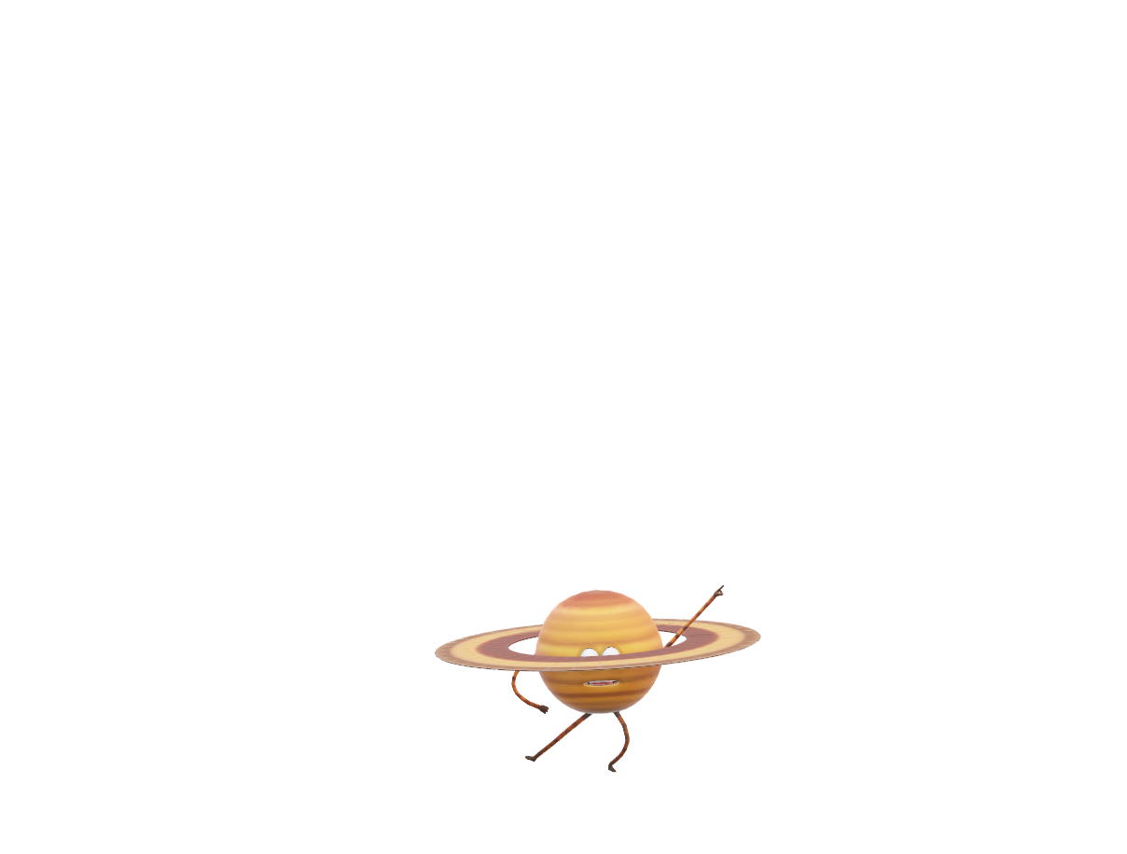
CALCULUS IN EVERYDAY LIFE SC107 (Calculus Fall 2023): Diwali Project
TOPIC: ORBITAL DECAY & SATELLITE MAINTENENCE

